Slide 1



Sex, Science and the Brain
Girls and Science: Don’t, Can’t or Won’t?
Professor Gina Rippon,
Chair of Cognitive NeuroImaging,
Aston Brain Centre, Aston University
July 2015

Slide 2

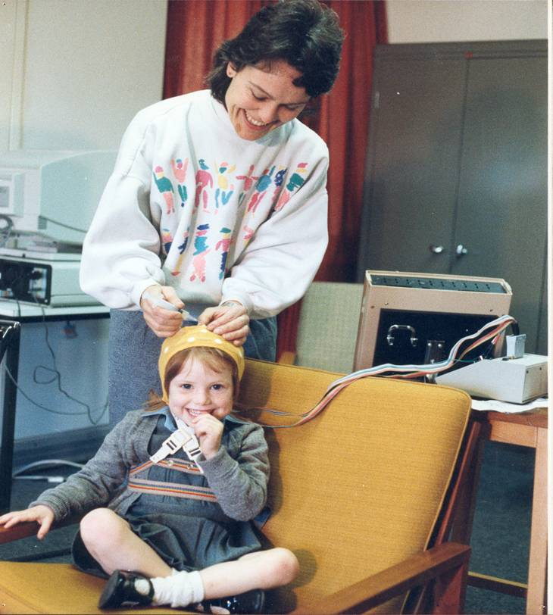
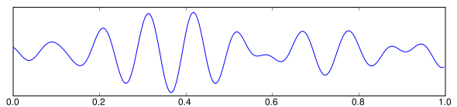

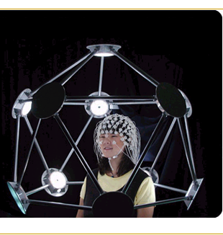
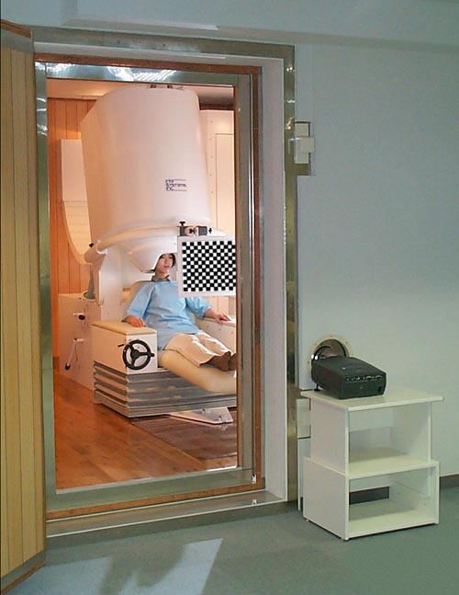
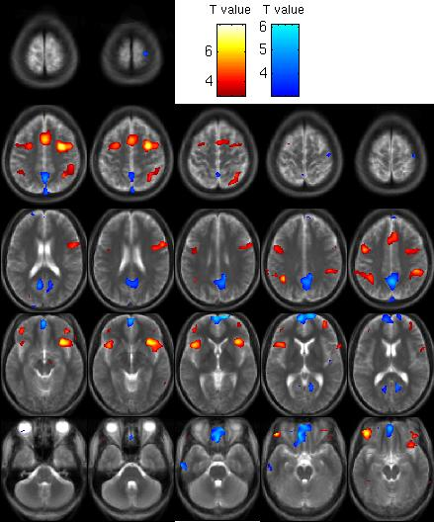
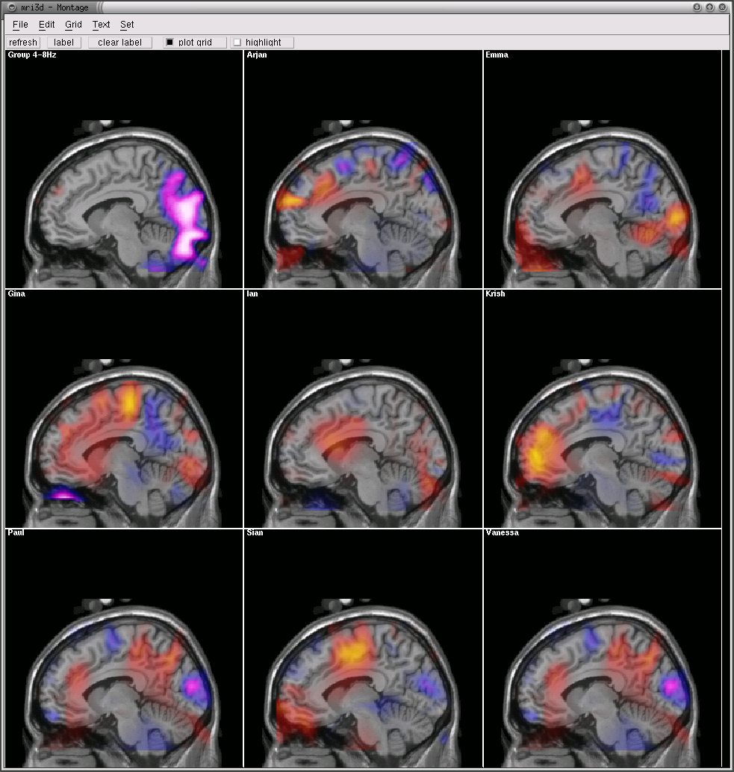
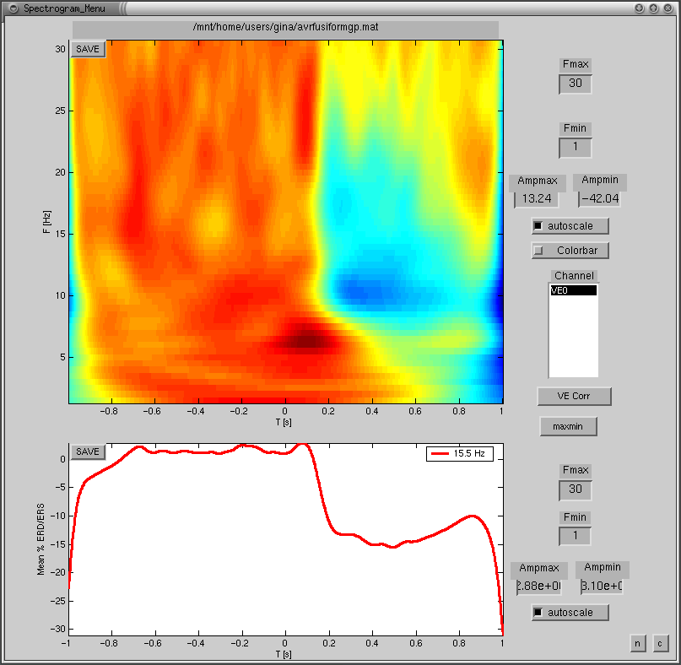
Cognitive Neuroscientist @Aston Brain Centre
ELECTROENCEPHALOGRAPHY [EEG]
FUNCTIONAL
MAGNETIC RESONANCE IMAGING
[fMRI]
MAGNETO-
ENCEPHALOGRAPHY
[MEG]

Slide 3
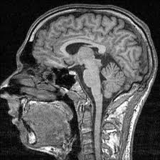
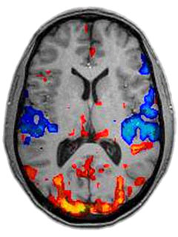
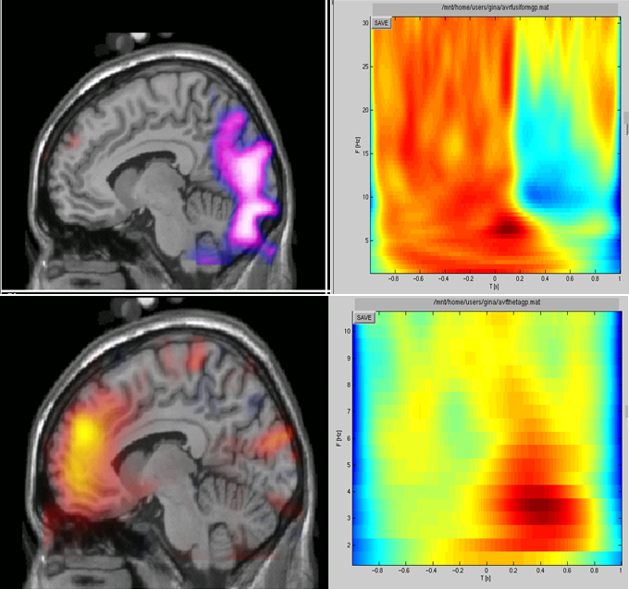
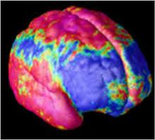
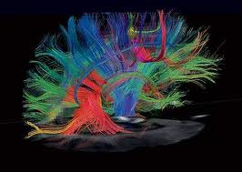
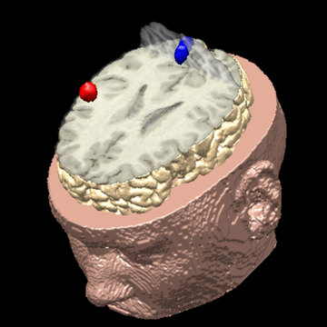


Slide 4
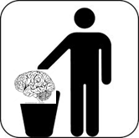
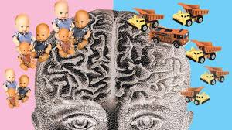
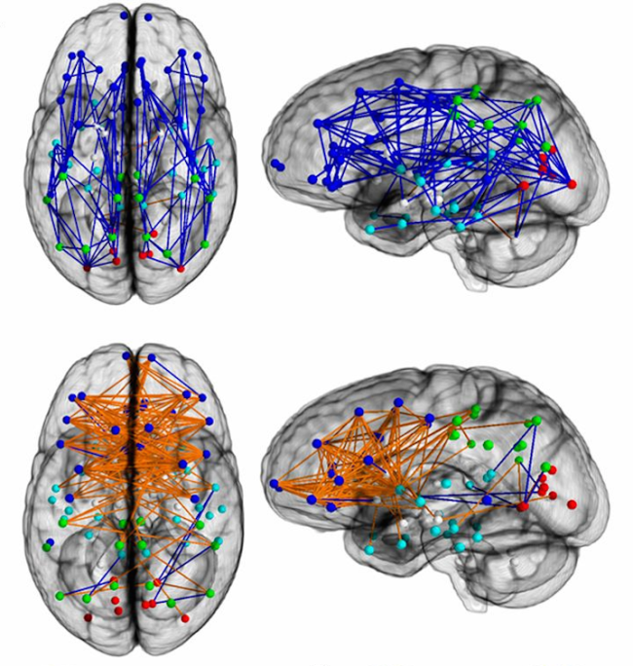



NeuroNonsense
Neurotrash
Neurosexism

Slide 5
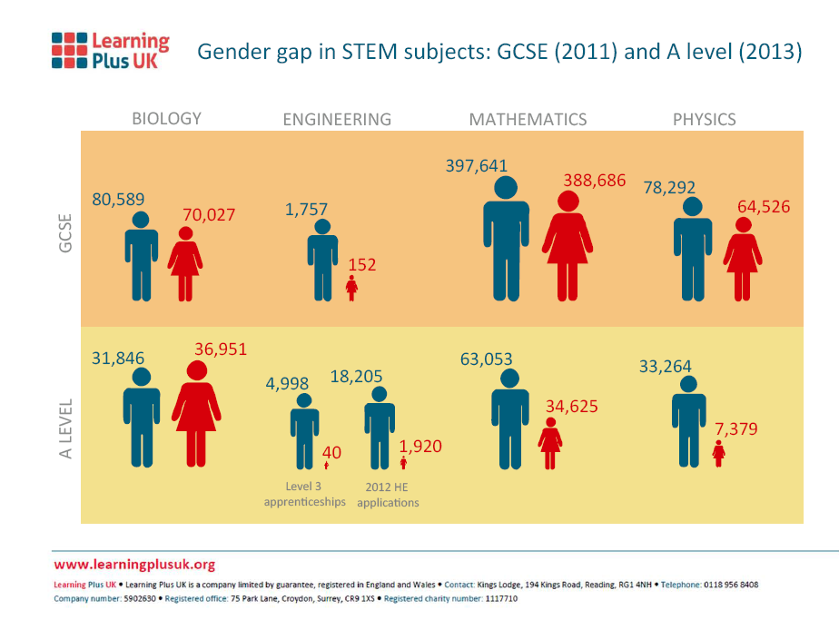
Sex, science and the brain
Is there a Problem?

Slide 6
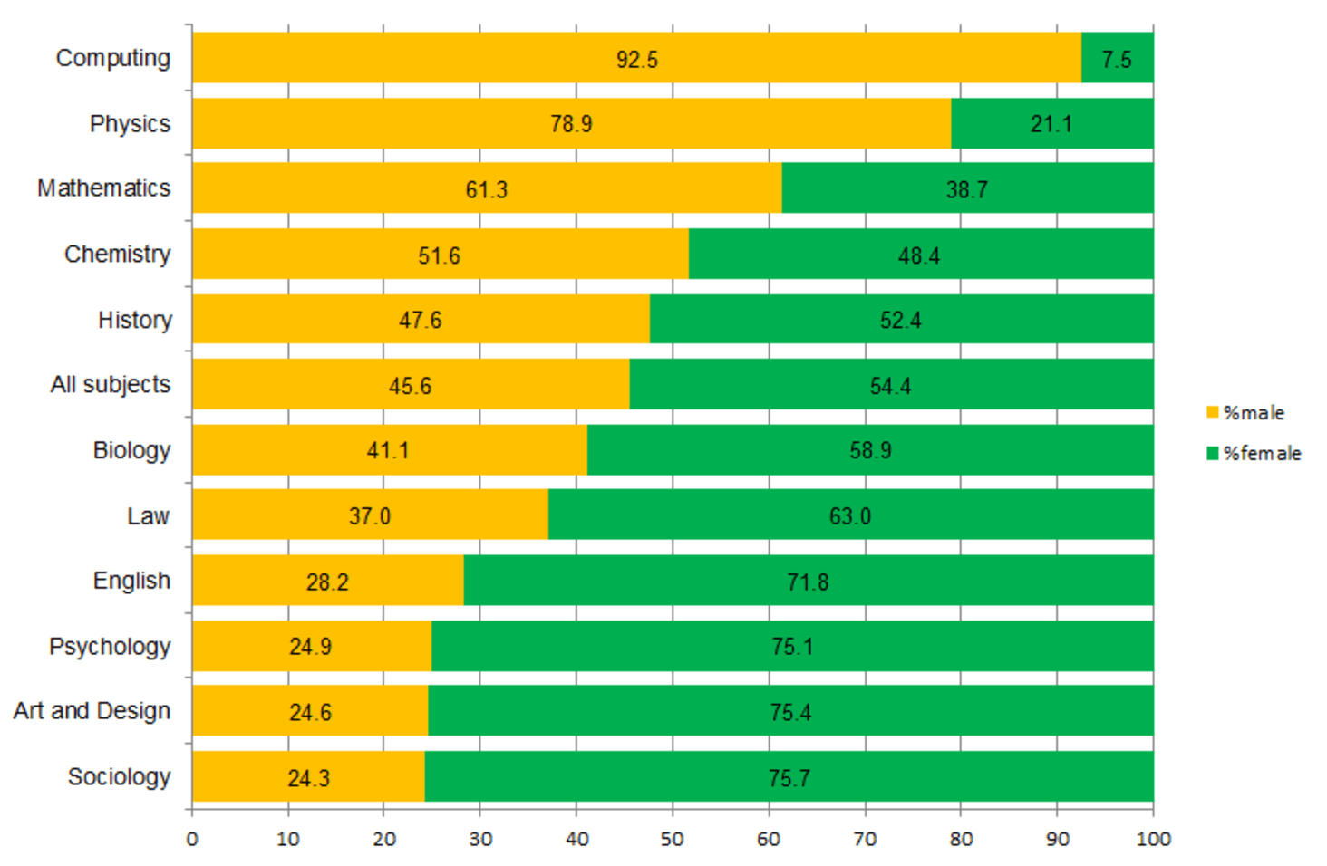
% of girls and boys taking A-level subjects in 2014

Slide 7
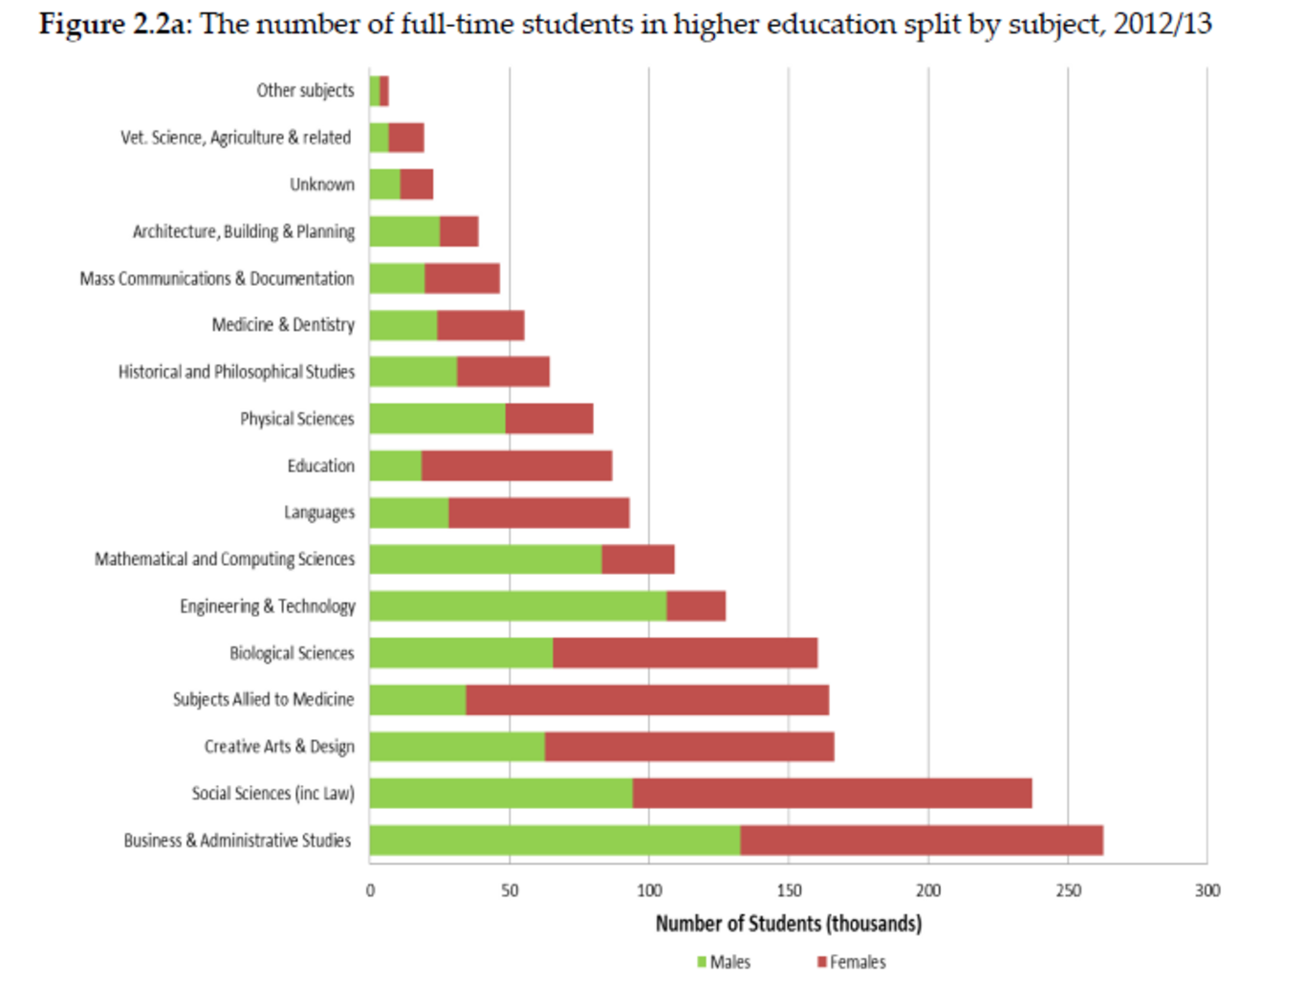

Slide 8
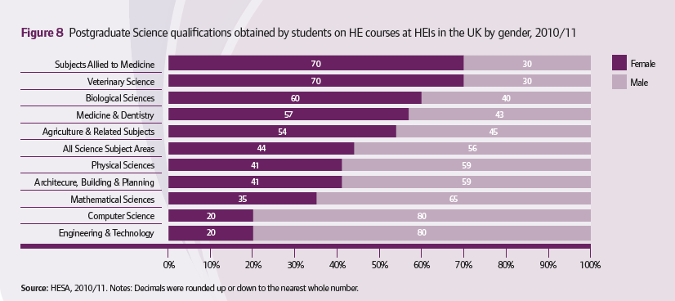
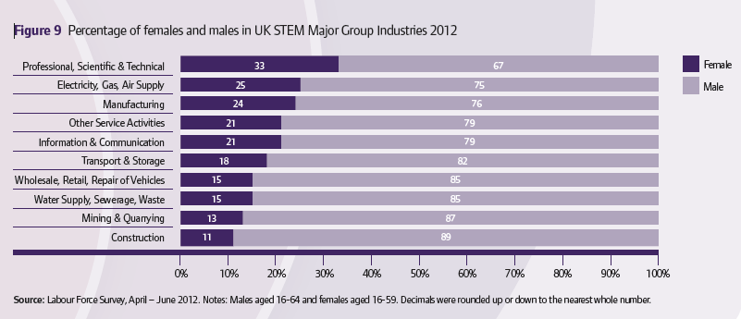

Slide 9

Why are there so few female scientists?
Brain Level: Do girls just not have a ‘Science’ Brain’ ? [CAN’T]
Cognitive level: Do girls just not have ‘what it takes?’ [CAN’T]
Behavioural level: Do girls just choose not to do Science? [WON’T]

Slide 10
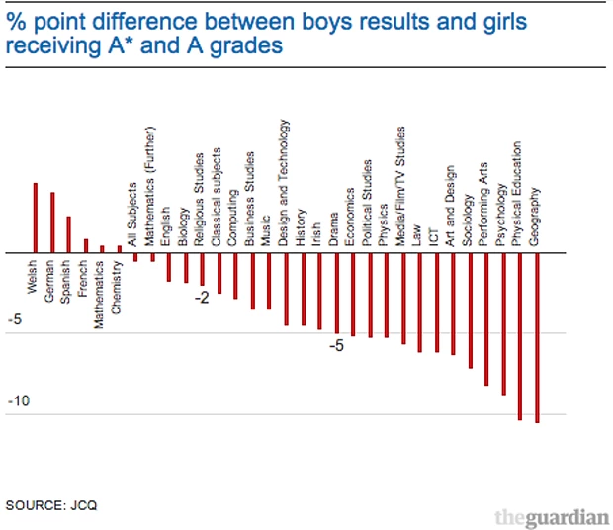
?Girls Can’t Do Science

Slide 11
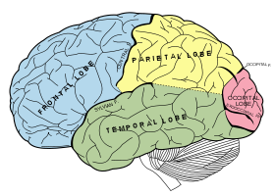
Brain differences – Size matters?
1850 – frontal cortex as repository of highest mental capacities:
  Rudinger, 1877 – man is homo frontalis, woman is homo parietalis – frontal lobes in man in every way more extensive than those of women
1895– parietal lobes the seat of intellect – ‘..the frontal region is not, as has been supposed smaller in women, but rather larger relatively…. The parietal lobe is somewhat smaller. A preponderance of the frontal region does not imply intellectual superiority…the parietal region is really the more important (Patrick, 1895)

Slide 12
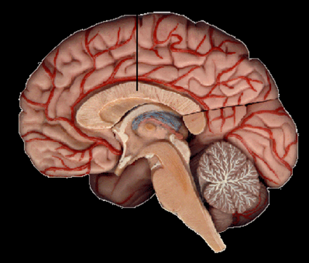
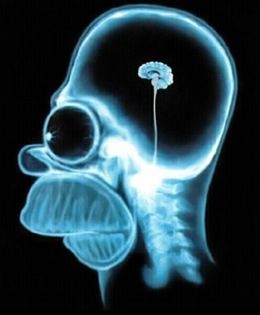
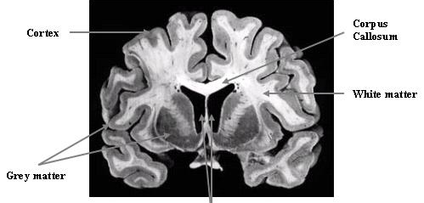
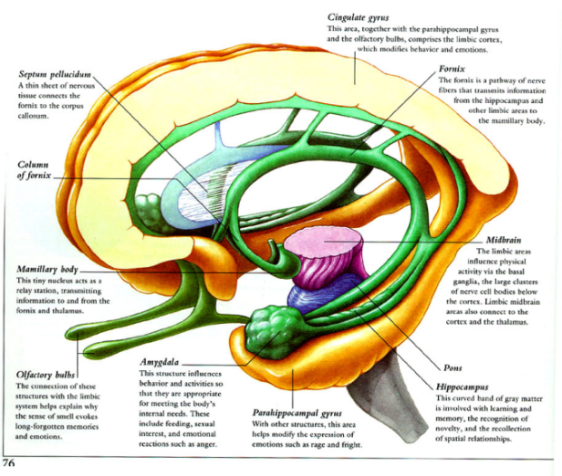
“
“
“
“Men and women do have different brains? Size matters.

Slide 13
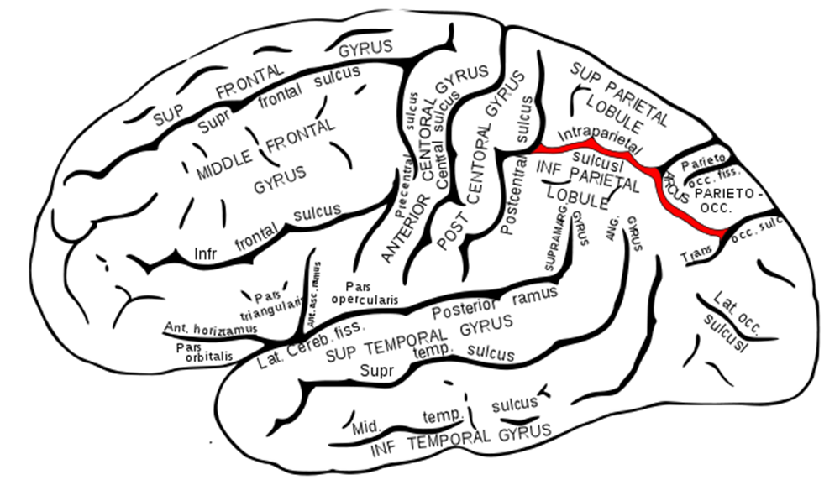
The Scientific Brain – the spatial brain, the systemising brain
Parietal area –representation of quantity; spatial processing
Prefrontal areas (working memory, rules)
visual areas including fusiform gyrus, encoding object properties)

Slide 14

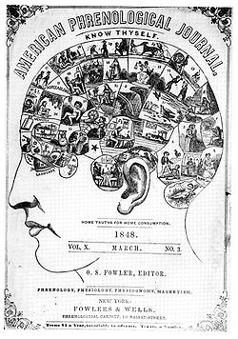



Beware the mind mapping illusion.

Slide 15
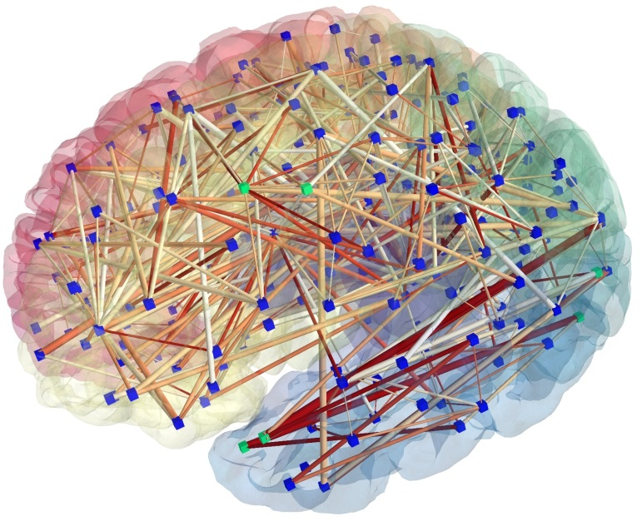
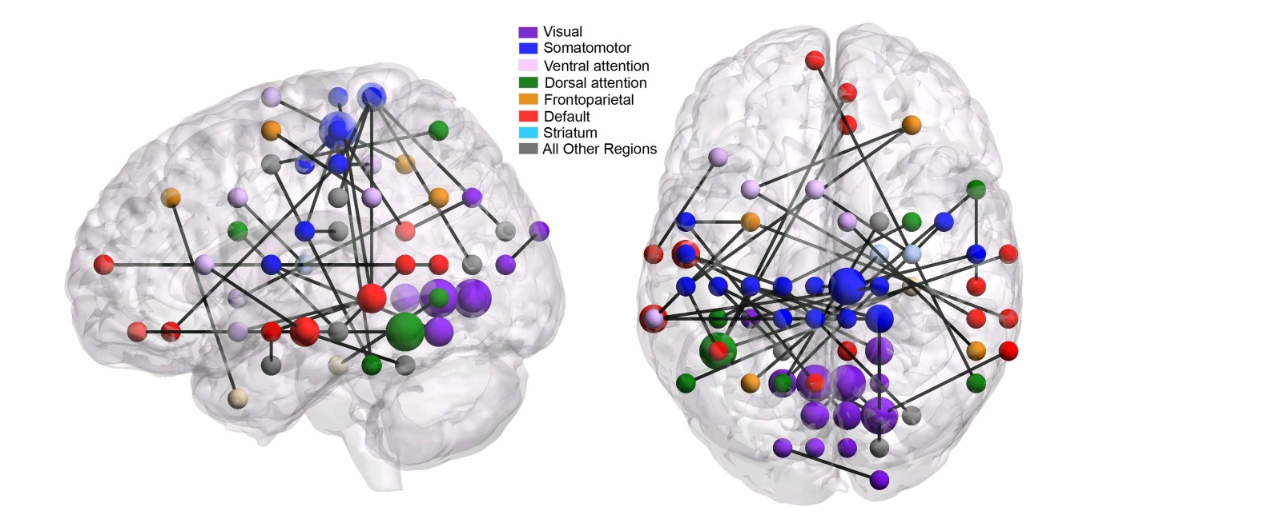
THE CONNECTED BRAIN

Slide 16
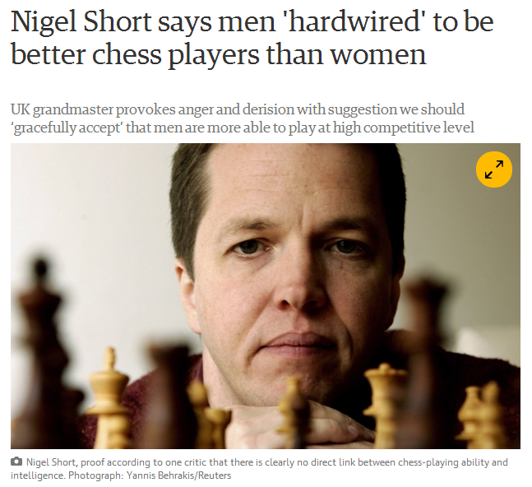
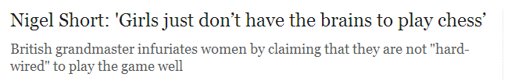

“Men and women do have different brains. This is a biological fact.

Slide 17

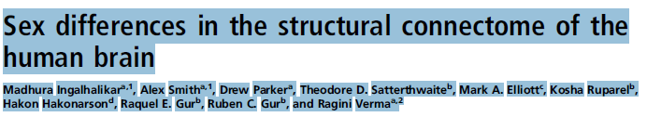
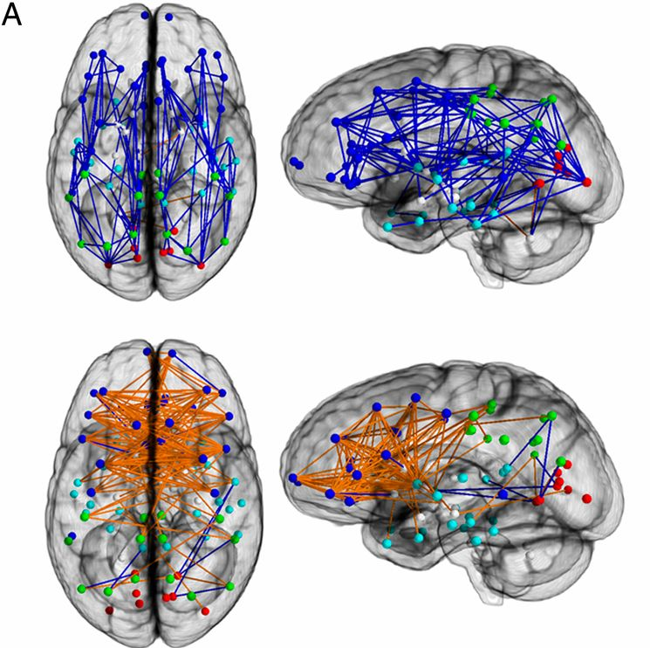
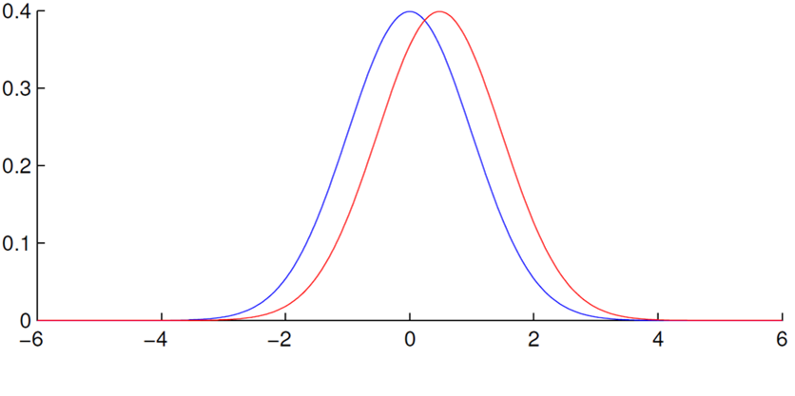
Connection-wise analysis.
“Taken together, these results reveal fundamental sex differences in the structural architecture of the human brain. ……The observations suggest that male brains are structured to facilitate connectivity between perception and coordinated action, whereas female brains are designed to facilitate communication between analytical and intuitive processing modes.”
“Males have better motor and spatial abilities, whereas females have superior memory and social cognition skills”
©2014 by National Academy of Sciences
Notes:
Connection-wise analysis. (A) Brain networks show increased connectivity in males (Upper) and females (Lower). Analysis on the child (B), adolescent (C), and young adult (D) groups is shown. Intrahemispheric connections are shown in blue, and interhemispheric connections are shown in orange. The depicted edges are those that survived permutation testing at P = 0.05. Node color representations are as follows: light blue, frontal; cyan, temporal; green, parietal; red, occipital; white, subcortical. GM, gray matter.

Slide 18
Why are there so few female scientists?
Brain Level: Do girls just not have a ‘Science’ Brain’ ? [CAN’T]
Cognitive level: Do girls just not have ‘what it takes?’ [CAN’T]
Behavioural level: Do girls just choose not to do Science? [WON’T]

Slide 19

Why aren’t there more women mathematicians?
Is it because they can’t?
Larry Summers - 2005 speech in which he suggested that the under-representation of women in science and engineering could be due to a "different availability of aptitude at the high end,"
Notes:
HOWEVER – is there an underlying concern that no matter what policy initiatives you set up, women may be under-represented in STEM subjects because of an innate deficiency – the old ‘Biology is Destiny’ argument.

Slide 20
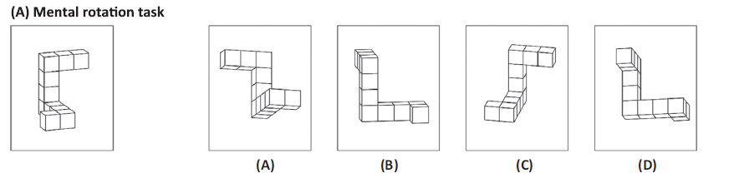
Male brains are spatial brains?

Slide 21
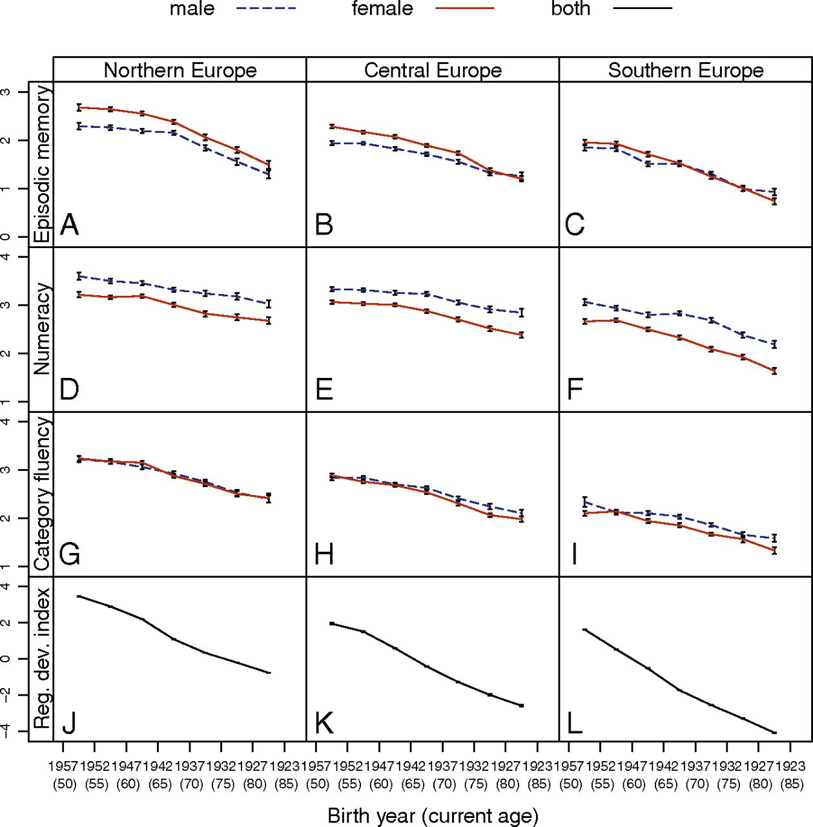
GENDER DIFFERENCES IN COGNITIVE SKILL – FIXED OR FLUID?
Hyde (2014) – Gender Similarities and Differences. Ann. Rev. Psychol.
Overall, girls have reached parity with boys in mathematics performance, at least in the United States.
a moderate gender difference favouring males in 3D mental rotation.
(However, this gender difference may result from the absence of spatial training in the schools combined with major gender gaps in relevant out-of-school experiences)
Daniela Weber et al. PNAS 2014;111:11673-11678
©2014 by National Academy of Sciences
Notes:
Mean standardized performances (±SEM) in episodic memory (A–C), numeracy (D–F), and category fluency (G–I) per 5-y birth cohort by gender for Northern, Central, and Southern Europe. (J–L) Mean RDI (±SEM) per 5-y birth cohort for Northern, Central, and Southern Europe. As can be seen in A–I, gender differences in the cognitive tasks vary systematically across birth cohorts and regions (see Table S2 for raw mean differences, indicator of significance, pooled SD, and Cohen’s d). (J–L) RDI is lower in earlier birth cohorts, and Northern Europe has the highest RDI followed by Central and Southern Europe.

Slide 22
Innate differences in cognitive ability?
Males more focussed on mechanical systems from early on in life?
Human males are primarily interested in objects and their mechanical interactions [systemisers] whereas human females are primarily interested in people and their social and emotional interactions[empathisers] –
  Simon Baron-Cohen (2003)
No evidence that infants have different understanding of or responses to objects and their properties
Spelke, E.S.(2005) Sex Differences in Intrinsic Aptitude for Mathematics and Science: A Critical Review. American Psychologist, 60, 950–958.
Notes:
Developmental psychology – interested in evidence of very early differential interests in or responses to objects and their characteristics ( can they understand that an object hit hard will go further than an object merely tapped?) Simon Baron-Cohen has claimed that males show early interest in objects ( as opposed to faces). Not replicated and not supported by any evidence of gender differences in development of an understanding of the ‘object principles’.

Slide 23
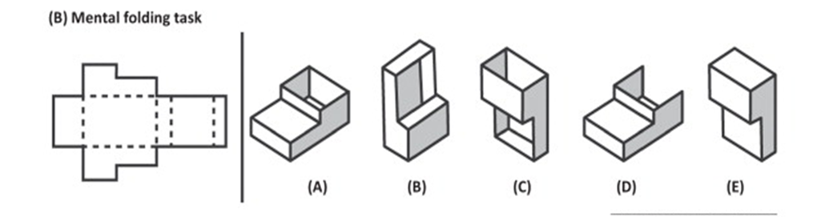
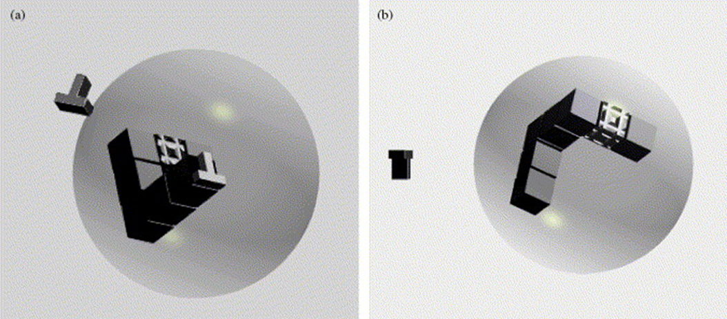
Mental Rotation ability

Slide 24
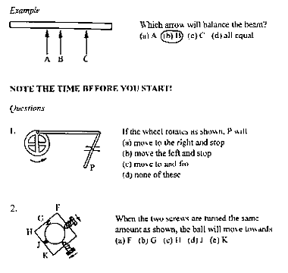
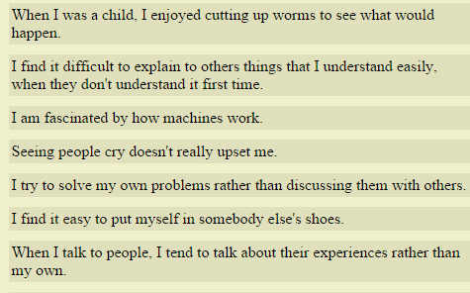
Systemising: drive to analyse and construct rule-based systems; rules that govern and predict how the system behaves.

Slide 25
Why are there so few female scietists?
Brain Level: Do girls just not have a ‘Science’ Brain’ ? [CAN’T]
Cognitive level: Do girls just not have ‘what it takes?’ [CAN’T]
Behavioural level: Do girls just choose not to do Science? [WON’T]

Slide 26

Why Don’t Girls do science?
Parents are more likely to encourage sons to take advanced high school classes in chemistry, maths and physics and have higher expectations for their success (Wigfield et al, 2002)
girls are thought to succeed because of effort and fail because of lack of ability, whereas boys are thought to succeed because of ability and fail because of lack of effort.(Gunderson, E. A., et al (2012).

Slide 27

Why Don’t Girls do science?
Teachers – On the Origins of Gender Human Capital Gaps: short and long term consequences of teachers’ stereotypical biases (Lavy and Sand, 2015.
  8000 primary school pupils: Mismatch between classroom-based and national assessments – boys marked higher, girls marked lower
  Bias score determined
    middle school test scores
    high school matriculation scores
    students ratings of ability
    choice of STEM subjects.

Slide 28

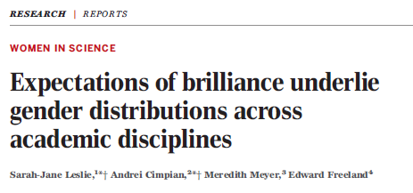
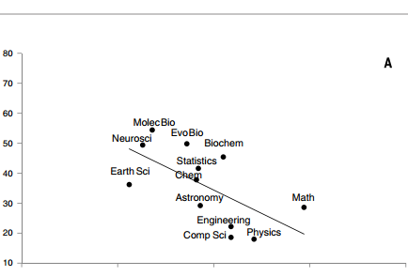
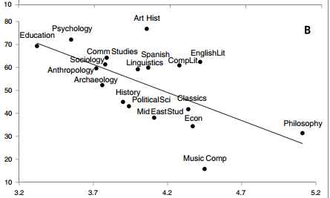

Why Don’t Girls do science?

Slide 29

Why Don’t Girls do science?
‘Employers’ hiring employees for arithmetic task
  Appearance only – men twice as likely to be hired as women
  Self-report – men ( who over-estimated performance) more likely to be hired than women ( who underestimated)
  Past performance data – reduced but did not eliminate bias.
How stereotypes impair women’s careers in science (Reuben et al, 2014)

Slide 30
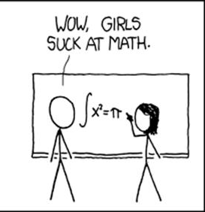
Stereotype threat.
Stereotype threat is the experience of anxiety or concern in a situation where a person has the potential to confirm a negative stereotype about their social group
Covert (‘in the air’) or overt (priming) stereotype threat results in significant decline in performance
Notes:
Given that we have seen that the environment can affect the brain, it could be relevant to consider what there is in the environment that might influence the developing brain.
Social psychology has demonstrated the effect of negative stereotypes on performance, in ethnic minorities as well as in other groups who differ on some measure. Exposure to the belief that the group to which you belong underperforms at some task will result in a significant deficit in performance on that task.

Slide 31
NeuroNonsense
Neurotrash
Neurosexism

Slide 32




Slide 33
Connection-wise analysis.
“Taken together, these results reveal fundamental sex differences in the structural architecture of the human brain. ……The observations suggest that male brains are structured to facilitate connectivity between perception and coordinated action, whereas female brains are designed to facilitate communication between analytical and intuitive processing modes.”
“Males have better motor and spatial abilities, whereas females have superior memory and social cognition skills”
©2014 by National Academy of Sciences
Notes:
Connection-wise analysis. (A) Brain networks show increased connectivity in males (Upper) and females (Lower). Analysis on the child (B), adolescent (C), and young adult (D) groups is shown. Intrahemispheric connections are shown in blue, and interhemispheric connections are shown in orange. The depicted edges are those that survived permutation testing at P = 0.05. Node color representations are as follows: light blue, frontal; cyan, temporal; green, parietal; red, occipital; white, subcortical. GM, gray matter.

Slide 34
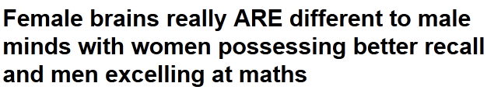
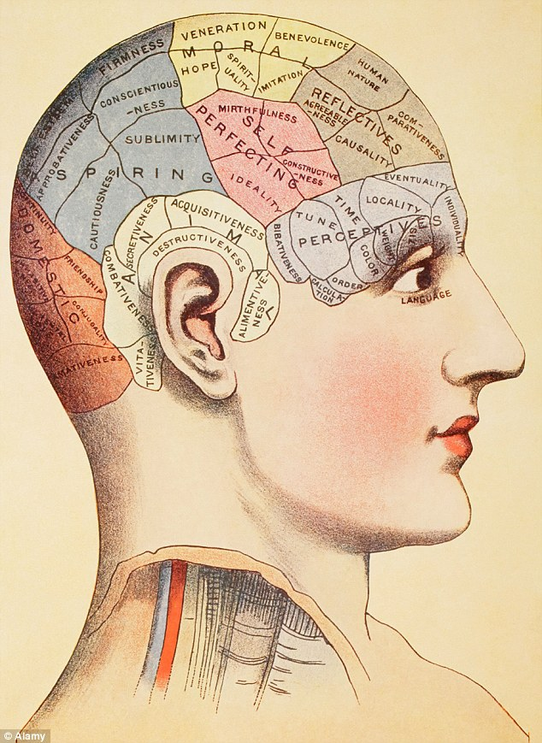

Slide 35

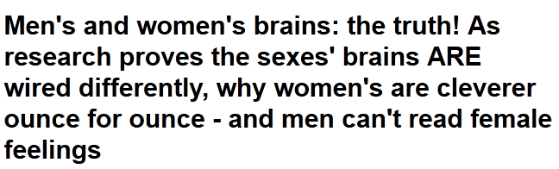
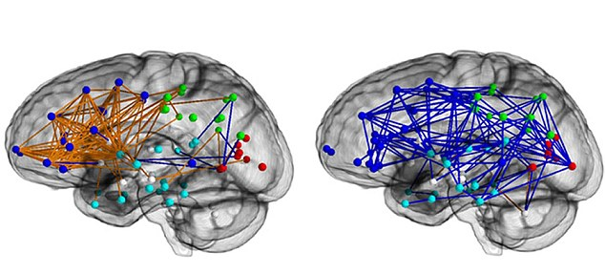

Slide 36




The permeable brain: The hardwired brain or the entangled brain?

Slide 37



Stereotype threat and Maths anxiety
Attentional bias towards negative feedback
Earlier termination of tasks following negative feedback
Failure to access additional support
Girls show higher levels of maths anxiety than boys

Slide 38


Depiction of regions and scatter plots from Analysis 1.
Ian M. Lyons, and Sian L. Beilock Cereb. Cortex 2012;22:2102-2110
© The Author 2011. Published by Oxford University Press. All rights reserved. For permissions, please e-mail: journals.permissions@oup.com
Notes:
Depiction of regions and scatter plots from Analysis 1. No effects of hemisphere were found for IFJ regions; thus data are averaged across the 2 hemispheres in the scatter plot above. Shaded areas in the scatter plots represent 95% confident intervals (observed) for the fitted linear regression line. MC, math cue; WC, word cue. Y-axis: math deficits (higher number = higher math [relative to word] error rate).

Slide 39
Solving the female scientist ‘problem’?
Our brains are plastic!
Beware neurononsense.
Empower our girls!

Slide 40




The plastic brain:
Neuroplasticity, Biology is not destiny

Slide 41




Gender differences in spatial cognition – effects of experience.

Slide 42





Brain imaging: part of the problem or part of the solution?

Slide 43



Slide 44
GENDER DIFFERENCES IN COGNITIVE SKILL – FIXED OR FLUID?
Hyde (2014) – Gender Similarities and Differences. Ann. Rev. Psychol.
Overall, girls have reached parity with boys in mathematics performance, at least in the United States.
a moderate gender difference favouring males in 3D mental rotation.
(However, this gender difference may result from the absence of spatial training in the schools combined with major gender gaps in relevant out-of-school experiences)
Daniela Weber et al. PNAS 2014;111:11673-11678
©2014 by National Academy of Sciences
Notes:
Mean standardized performances (±SEM) in episodic memory (A–C), numeracy (D–F), and category fluency (G–I) per 5-y birth cohort by gender for Northern, Central, and Southern Europe. (J–L) Mean RDI (±SEM) per 5-y birth cohort for Northern, Central, and Southern Europe. As can be seen in A–I, gender differences in the cognitive tasks vary systematically across birth cohorts and regions (see Table S2 for raw mean differences, indicator of significance, pooled SD, and Cohen’s d). (J–L) RDI is lower in earlier birth cohorts, and Northern Europe has the highest RDI followed by Central and Southern Europe.

Slide 45

Else-Quest et al (2010); 493,495 students 14–16 years; 69 countries
Gender equity in school enrolment, women’s share of research jobs, and women’s parliamentary representation were the most powerful predictors of cross-national variability in gender gaps in math.

Slide 46
Why are there so few female scientists?
Brain Level: Do girls just not have a ‘Science’ Brain’ ? [CAN’T]
Cognitive level: Do girls just not have ‘what it takes?’ [CAN’T]
Behavioural level: Do girls just choose not to do Science? [WON’T]

Slide 47

Girls Don’t Do Science:
Can’t? Or Won’t?
The Brain as the Problem?
Of hardwiring and the ‘natural order of things’
Society as the Problem?
  Too Pretty to Do Maths?
The Brain as the Solution?
  The Entangled Brain - Of Plasticity and Permeability

Slide 48




Sex, maths and the Brain – Is there a problem? YES BUT WE CAN SOLVE IT!
Thank you
Any questions?

