Slide 1

Gender at the core of European Research: Horizon 2020
Capitolina Díaz –Universitad de Valencia
ADEIT – Valencia
July 6-7, 2015

Slide 2


Slide 3
Why action is needed?
Under representation of women
Bias science

Slide 4
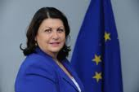
“The under-representation of women deprives them of the opportunity to contribute towards research and innovation on an equal footing; and, given the different perspectives that women bring, the quality of research and innovation suffers as well.”
“Gender imbalance in research is not a self-correcting phenomenon and so we must redouble our efforts.
This is why I have pushed hard to ensure that the promotion of gender equality is an integral part of the UE strategy to establish the ERA”
Máire
Geoghegan-Quinn

Slide 5
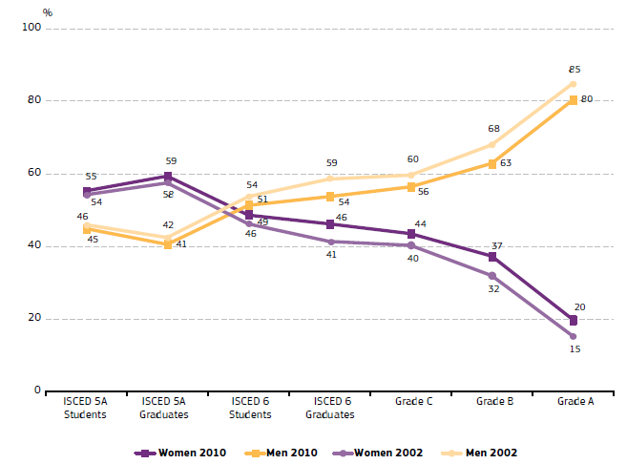
Proportion of men and woman in a typical academic career, students and academic staff. EU 27, 2002-2010.
Notes:
SHE FIGURES 2012: Proportion of men and women (all fields)
in a typical academic career. EU 27
We still have too few female researchers despite the rise in the number of female PhD holders. Women represent 46% of PhD graduates in the EU, but only 33% of our researchers.
The gender imbalance is even more striking in top positions, where only 20% of senior academic staff are women, 15% are Heads of institutions and 10% are Rectors in the Higher Education Sector.

Slide 6
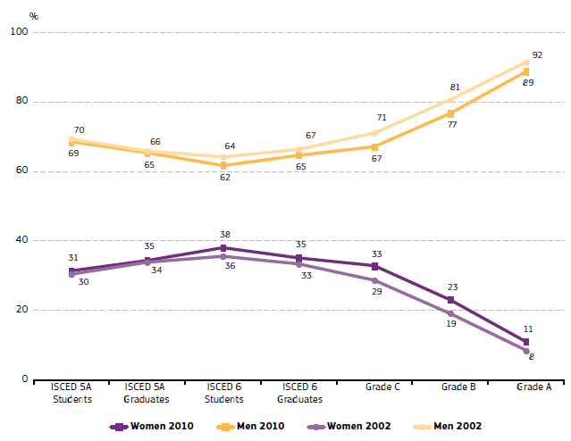
Proportion of men and women (Science and Engineering) in a typical academic career. EU 27

Slide 7
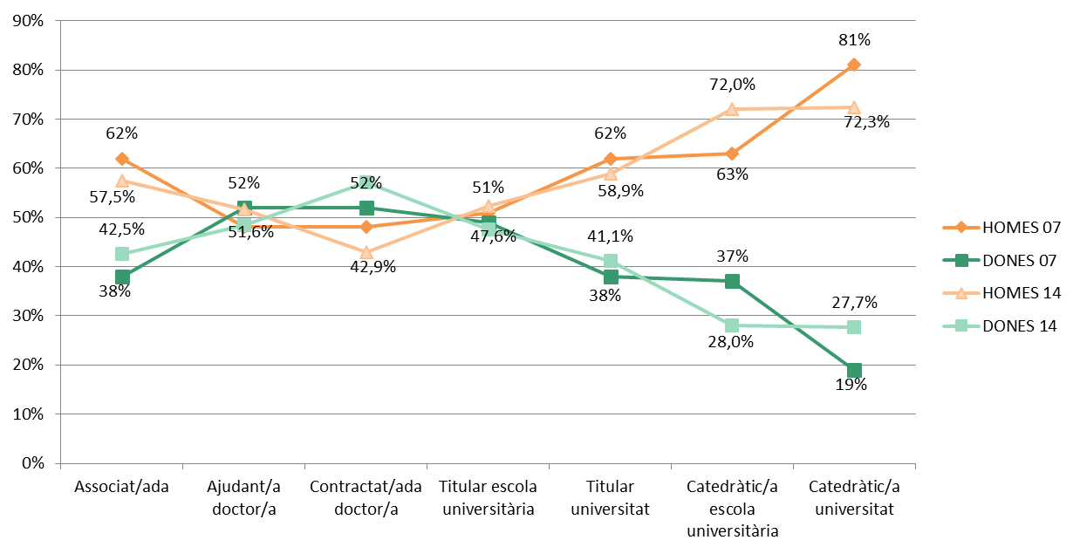
Academic staff University of Valencia by categories (2007 y 2014).

Slide 8
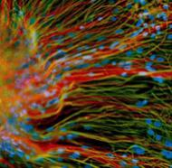
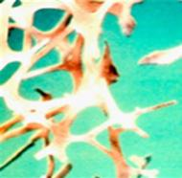
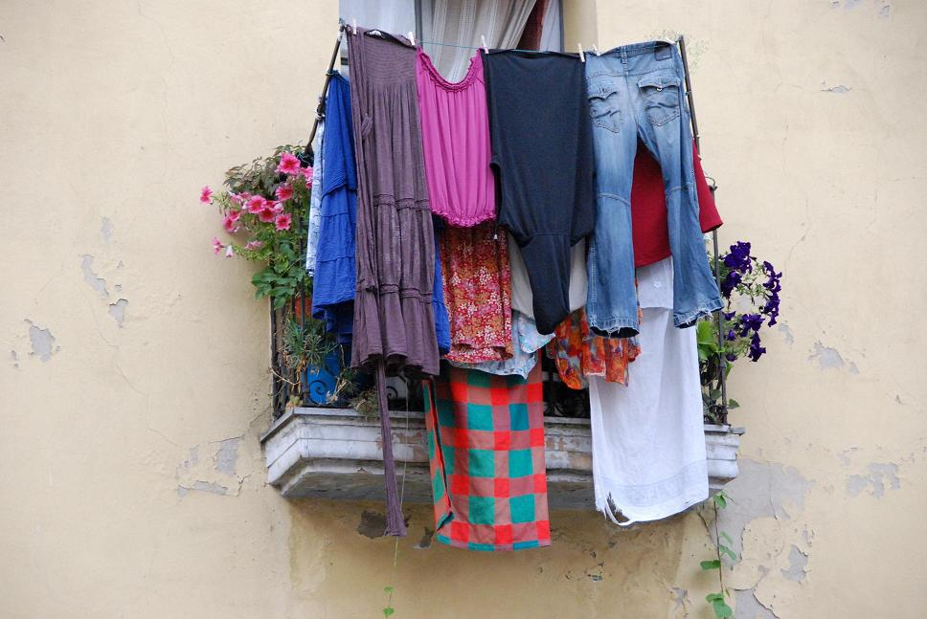
BIAS SCIENCE
Stem cells: no analysis of biological sex lost oportunity to refine cell-based therapies.
Osteoporosis: Men account for nearly a third of osteoporosis-related hip fractures in Europe and the U.S.
Need of a
new perspective on science.
Architecture
Notes:
Células Madre: Biological sex is commonly studied as a variable in research with humans, but analyzing sex is rare in animal research and rarer still in cell-based research (Beery et al., 2011). This deficiency can represent a lost opportunity to understand basic and developmental biology, and to refine cell-based therapies.
OSTEOPOROSIS EN HOMBRES
. (Dhanwal et al., 2010). Nonetheless, osteoporosis is considered primarily a disease of postmenopausal women, and men are rarely evaluated or treated for it (Szulc et al., 2012).

Slide 9
In 2005 the European Council established the goal of reaching 25% of women in the decision making positions in research in the public sector but in 2014 only 10% of universities and 15% of research institutions were governed by women.
Gender Equality is one of the five ERA priorities.

Slide 10
Five key ERA priorities
1. More effective national research systems.
2. Optimal transnational cooperation and competition.
An open labour market for researchers.
4. Gender equality and gender mainstreaming in research.
5. Optimal circulation, access to and transfer of scientific knowledge.

Slide 11
Implementing Gender on H2020: 3 objectives
Gender balance in decision making
Gender balance in research teams at all levels
Gender dimension in research and innovation content.
Notes:
Estos 3 objetivos siguen las líneas estratégicas de la Comisión sobre Igualdad de Género, así como los objetivos marcados por la Comunicación de julio de 2012 para el establecimiento del ERA (European Research Area). Están integrados en cada nivel del cliclo de Investigación e Innovación.
ERA is a unified research area open to the world based on the Internal market, in which researchers, scientific knowledge and technology circulate freely. Through ERA, the Union and its Member States will strengthen their scientific and technological bases, their competitiveness and their capacity to collectively address grand challenges…. to ensure the completion of ERA by 2014 as called for by the European Council

Slide 12
Gender Balance in decision making
Advisory groups
  50% men/women
  at least one expert with gender expertise
  Gender experts meet regularly
Evaluation panels and expert groups
40% under-represented sex
Taking into account women’s situation in the field of the action

Slide 13
To be included as expert, go to
http://ec.europa.eu/research/participants/portal/desktop/en/
experts/index.html

Slide 14
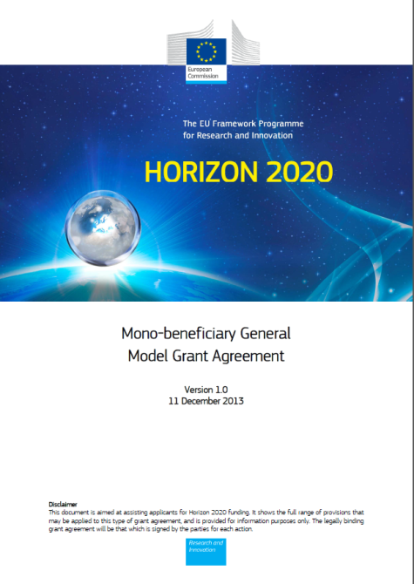
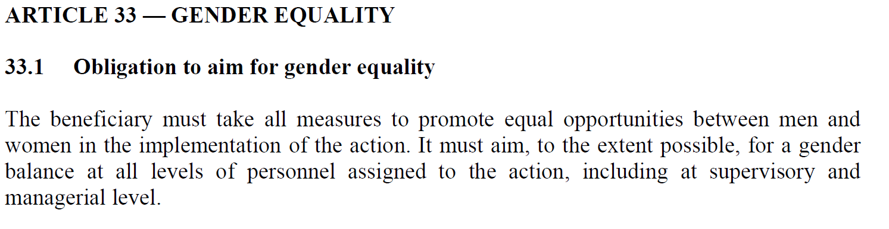
Gender balance in research teams: article 33 of the Model Grant Agreement

Slide 15
Gender Balance in reseach teams
Work programme: encourages balanced participation in research teams/management.
Proposal: Indicate gender of person responsable for carrying out the Project R&I activities.
Evaluation: If same scores, gender balance in teams=ranking factor.
Grant Agreement: Equal opportunities and gender balance at all levels
Periodic report: early reporting of workforce

Slide 16
The gender dimension in R & I content
Work programme: flagging topics with explicit gender dimension (+100 over 610)
Aplication form: “where relevant describe how sex and/or gender analysis is taken into account in the project content”
Evaluation: If relevant, as other parts of the proposal.
Grant Agreement
Reporting: If relevant as other parts of the proposal

Slide 17
Relevant to gender dimension
Besides the flagged areas, a topic is relevant in relation to gender when the topic or the research results can affect individuals or group of individuals. It should be taken into account even withought flagg.

Slide 18
Gender Relevance, examples (i)
Gender differences are relevants in health research to fight against illness and in basic research on genomics and its health applications.
In Information Tecnologies (ICTs) there are gender differences both at users level and in the labour market. If you asume thar ICT is neutral gender bias can enter in R&I and can have a negative impact on gender equality.
Some gender specific needs can be of interest for the development of material used in biomedicine.

Slide 19
Gender Relevance, examples (ii)
There can be gender differences in the efect of food on health that can be relevant for epidemiology derived from food and of relevant illness and alergies.
Gender differences are relevants in the design and development of sustainable technologies and in sectors such as transport.
https://www.youtube.com/watch?v=g_YOw-jXuEc

Slide 20
Mobilisation of gender expertise
Work programme: At least one gender expert in each advisory group to help preparing WP.
- Ad hoc Advisory Group on gender.
Proposal stage: Gender within responsibilities of NCPs coordinators; direct them to resources / trainings.
Evaluation
Where relevant, evaluators with gender expertise.
Grant Agreement
Training on gender issues among eligible costs of the action (Annex D of WP)

Slide 21
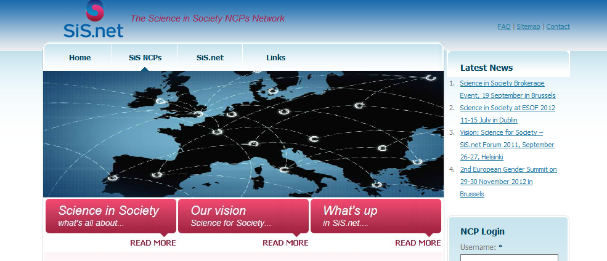
The role of National Contact Points
Gender equality is part of the mandate of NCPs dealing with Horizontal issues and Science with and for Society
Alert applicants to new features of Horizon 2020
Help applicants find appropriate resources / training
Mobilise gender expertise and help applicants find appropriate partners

Slide 22
WP 16: Science with and for Society
H2020 Specific Programme
The focus of activities on gender shall be to:
Promote gender equality, in particular by supporting structural changes in the organisation of research institutions and in the content and design of research activities;
Expected outcome of EC actions: increase the participation of women in research, improve their careers, achieve gender balance in decision making and further the excellence of R&I by integrating the gender dimension in research and innovation.

Slide 23
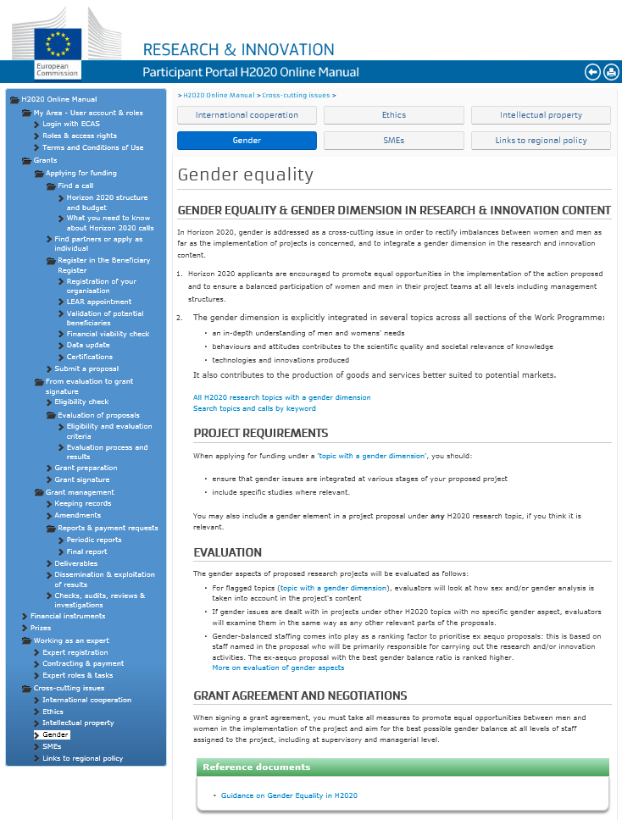
The Participant Portal:Gender, a cross-cutting issue
http://ec.europa.eu/research/participants/docs/h2020-funding-guide/cross-cutting-issues/gender_en.htm

Slide 24
WP 16: Science with and for Society
There is a specific call on “Gender equality in Reserch and Innovation” GERI.

Slide 25
Calls on Gender Equality- 2014-2015
Topic | Funding scheme | € Budget
GERI.3.2015 - Evaluation of initiatives to promote gender equality in research policy and research organisations | RIA | 2
GERI.4.2015 - Support to research organisations to implement gender equality plans: continuous support for the implementation of institutional changes in universities and research institutions | CSA | 7
Deadline 2015 calls : 16 September 2015

Slide 26
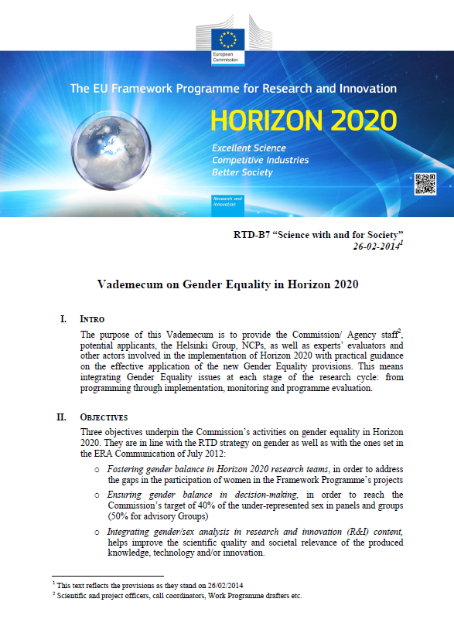
Resources o gender issues/expertise
The purpose of this Vademecum is to provide the Commission/ Agency staff, potential applicants, the Helsinki Group, NCPs, as well as experts’ evaluators and other actors involved in the implementation of Horizon 2020 with practical guidance on the effective application of the new Gender Equality provisions.
Notes:
26

Slide 27

... Resources on gender issues
GenPort – on-line community of practionners for sharing knowledge and inspire collaboration
www.genderportal.eu
Notes:
27

Slide 28
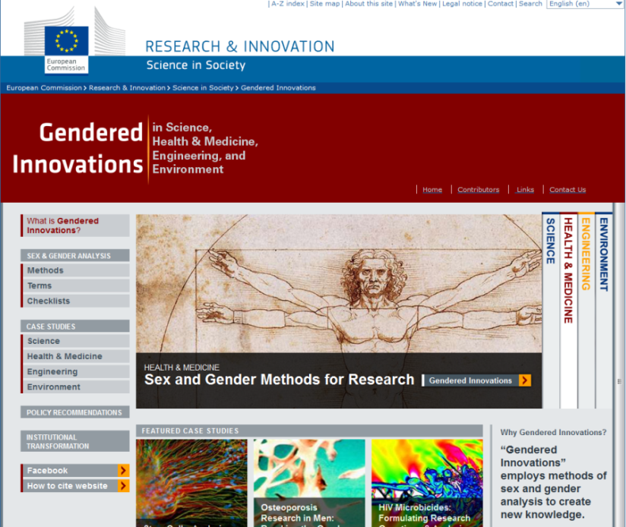
…Resources on gender issues
Gendered Innovations
http://ec.europa.eu/research/gendered-innovations/
Notes:
28

Slide 29
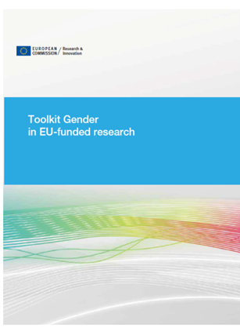
… Resources on gender isues
Gender Toolkit
http://www.yellowwindow.be/genderinresearch/

Slide 30
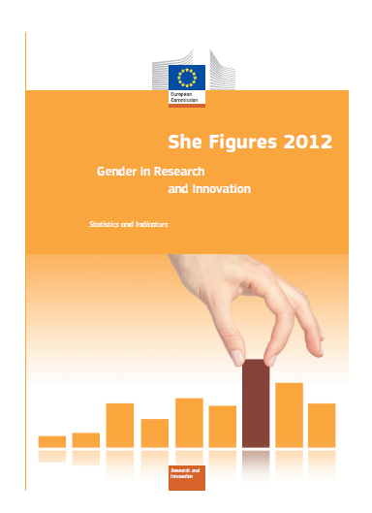

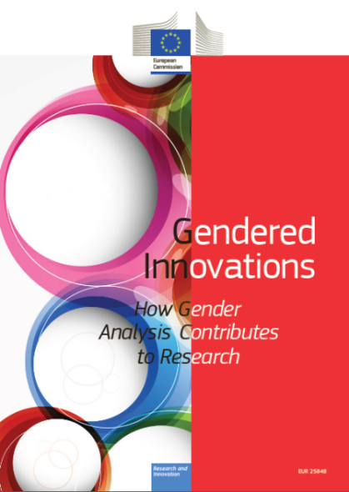

If you want to ask for a publication:

Slide 31

Science: it's a girl thing

Slide 32
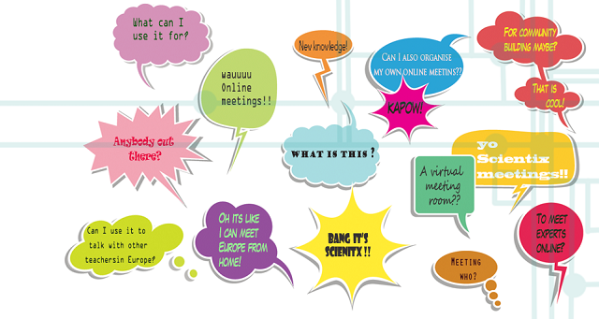
Scientix

Slide 34


capitolina.diaz@uv.es www.amit-es.org

